Slide 1
Statistics Analyzer of YouTube Videos with Spark
Yanyuan Qin and Renjie Chen

Slide 2

YouTube is the most popular video content provider
A billion users and every day people watch hundreds of millions of hours on YouTube and generate billions of views

Slide 3
Problems
How to get the video info?
How to analysis the data via the “state-of-art” technique?
What is the statistics of YouTube videos?
What is the relationship among YouTube video metrics?
Notes:
We are wondering what is inside this “giant”

Slide 4
Contributions
Build a platform with YouTube API to collect the data from YouTube server
Analysis the data via Spark
Get statistics features of YouTube video and user behaviors
Analyze the relationship between YouTube metrics

Slide 5
Data Collection
Top 50 videos in “Most viewed” every year
Top 50 videos in “top rated” every year
Also, look at their related 50 videos with BFS (depth = 2)
More than 500,000 videos

Slide 6
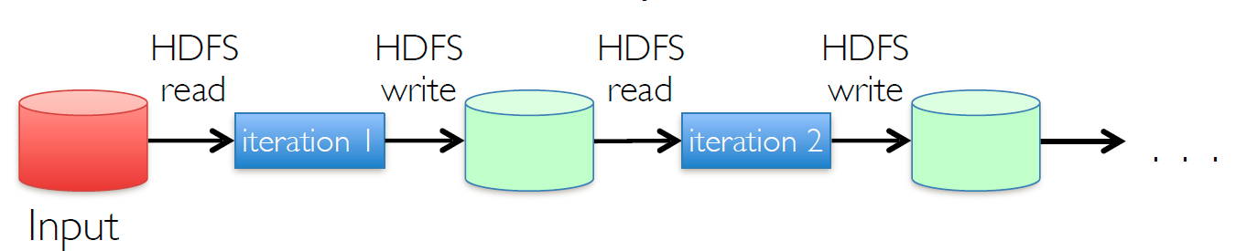
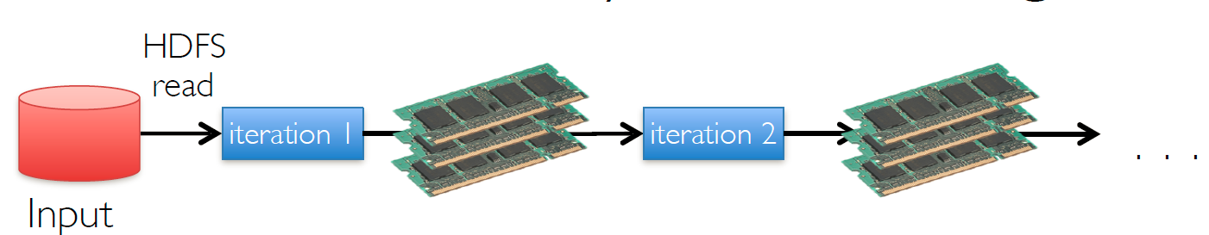
Why Spark?
Hadoop
Spark
10-100x faster than network and disk

Slide 7
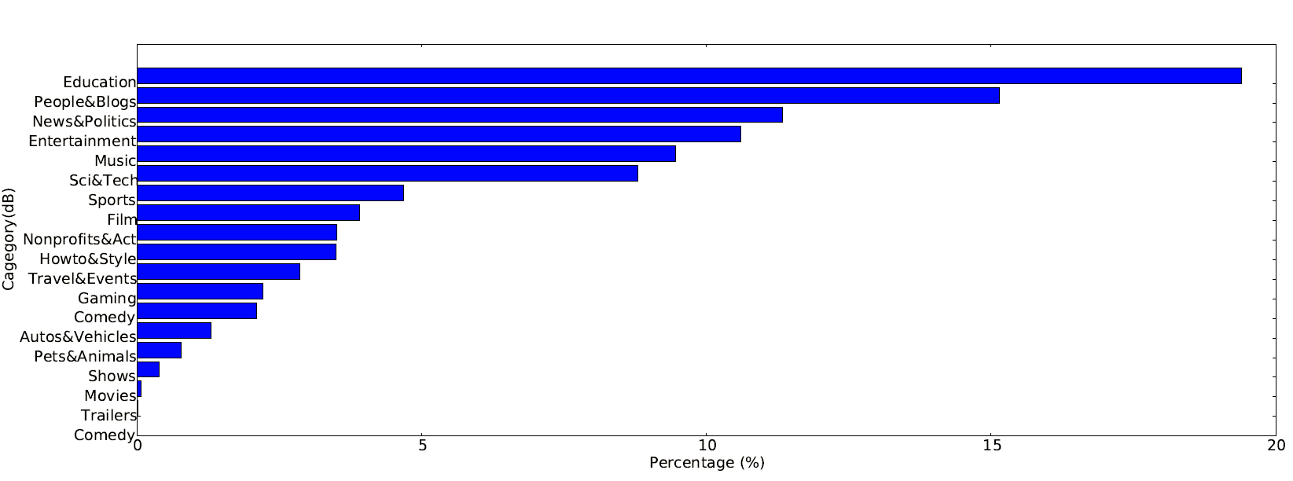
Distribution of YouTube video categories
More categories currently
Music and Entertainment is among the most popular categories all the time
Nowadays, Education, People& Blogs and News & Politics is the most popular categories
2007 Data Set
2017 Data Set

Slide 8
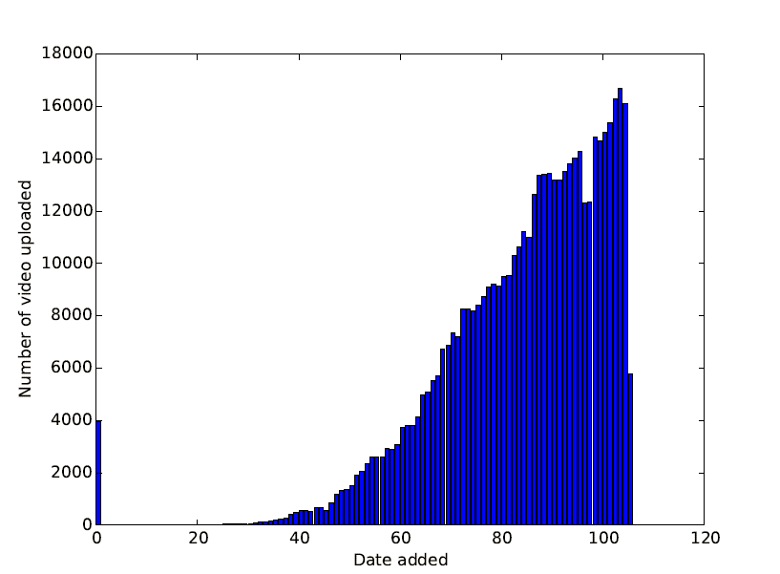
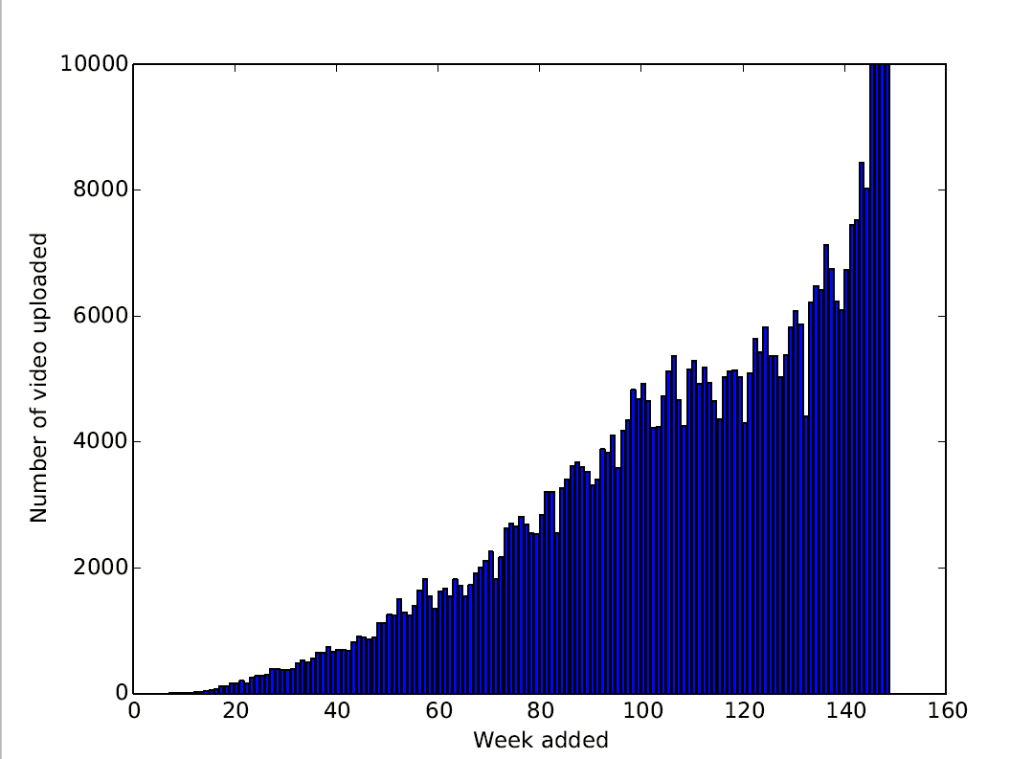
Uploading Trend of YouTube Videos
2007 Data Set
2017 Data Set
Upload trend follows the power curve

Slide 9
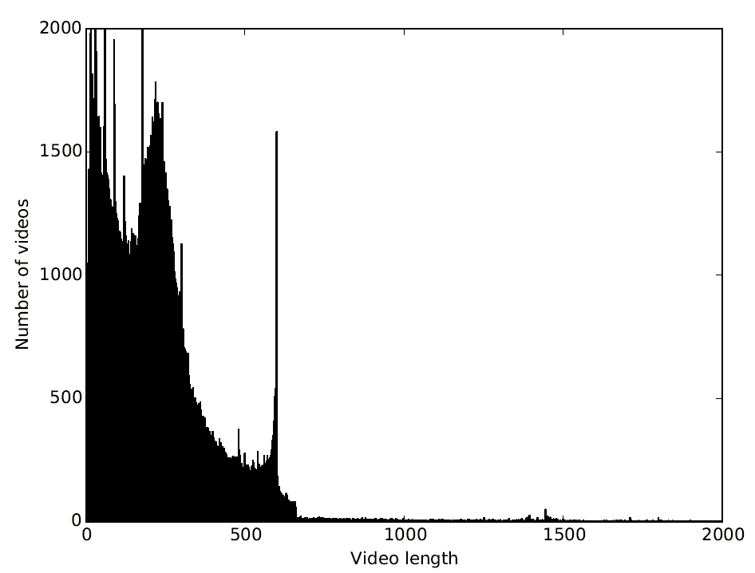
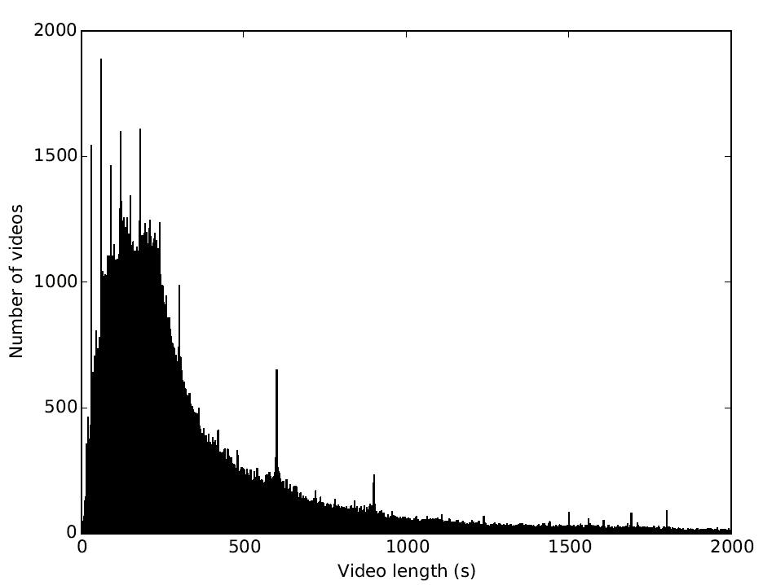
Distribution of YouTube video length
Rayleigh Distribution
2007 Data Set
2017 Data Set
Majority of video is within 10 min
But video is longer than before

Slide 10
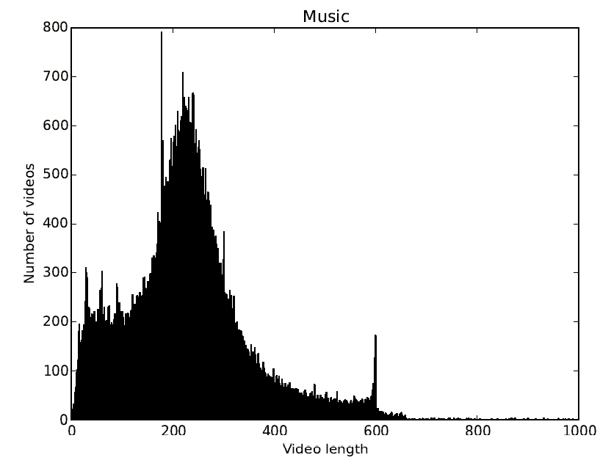
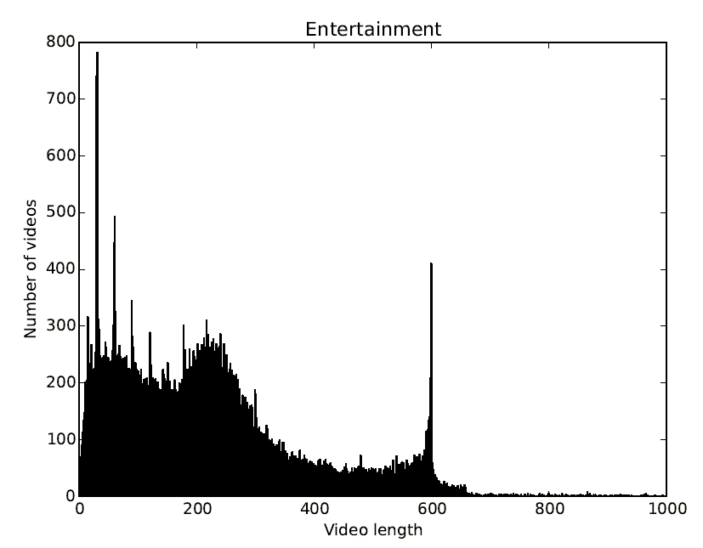
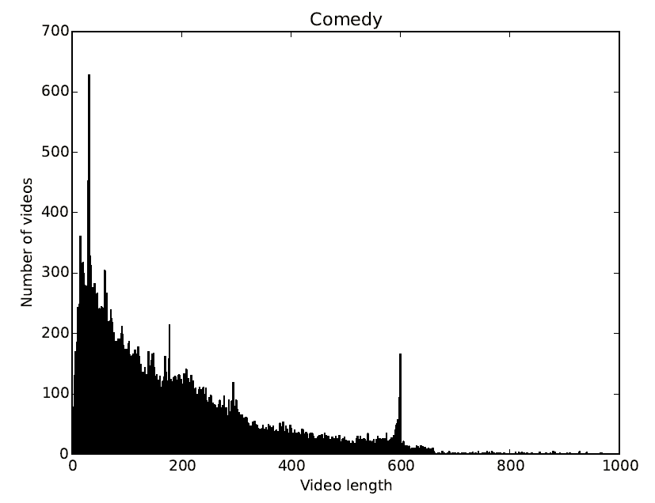
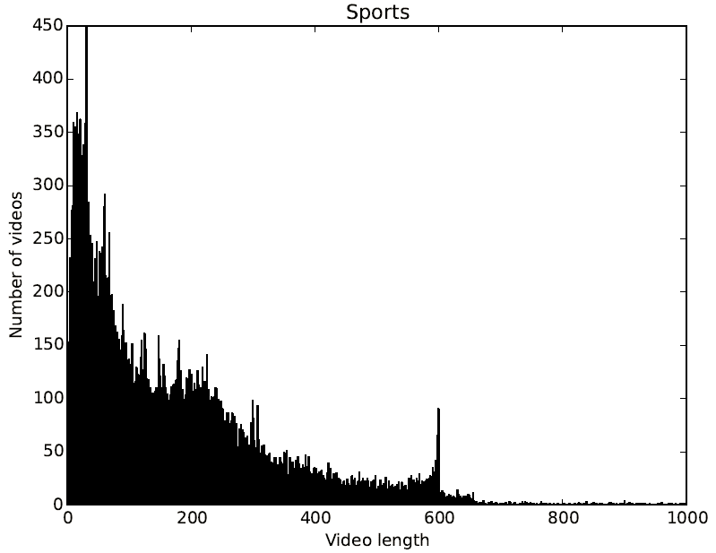
Distribution of YouTube video length for four most popular categories
Music: peak at 3~4 min
Entertainment: a cutoff around 10 mins
Comedy and Sports: more videos within 2 min
2007 Data Set

Slide 11
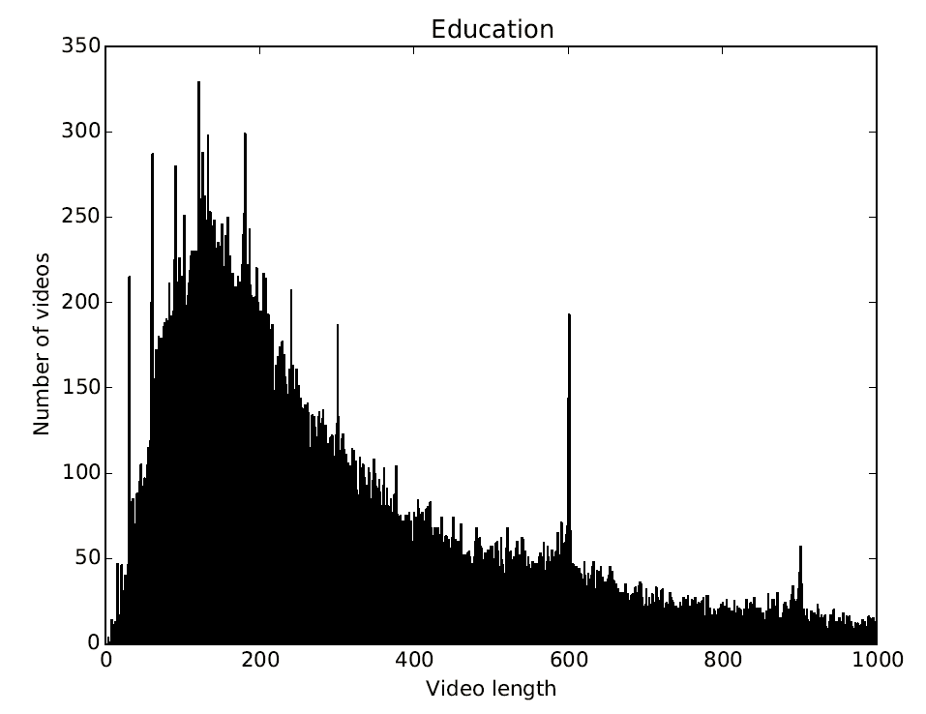
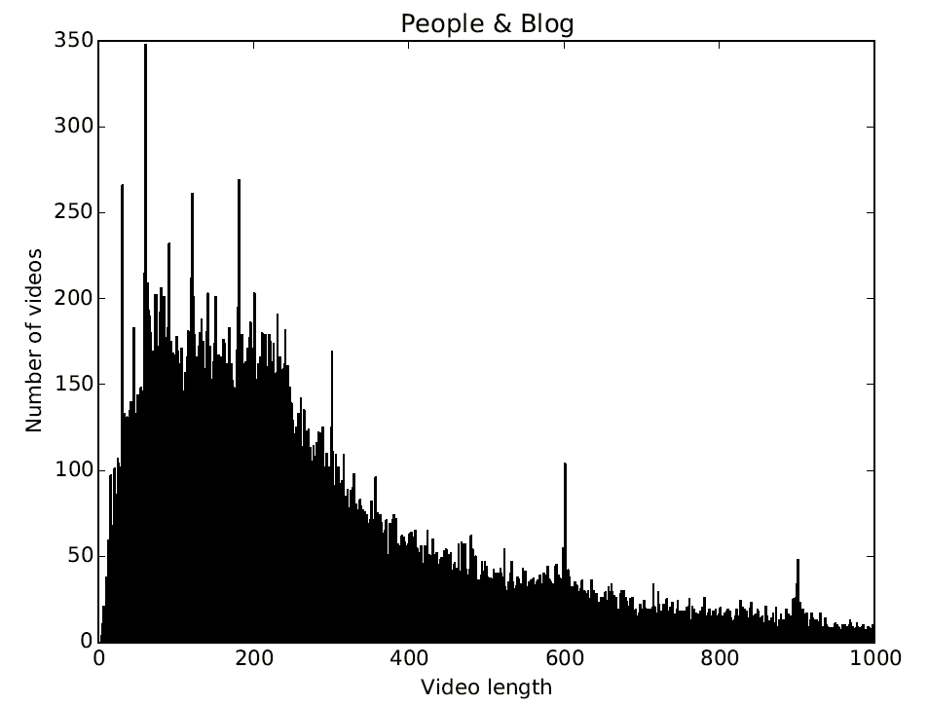
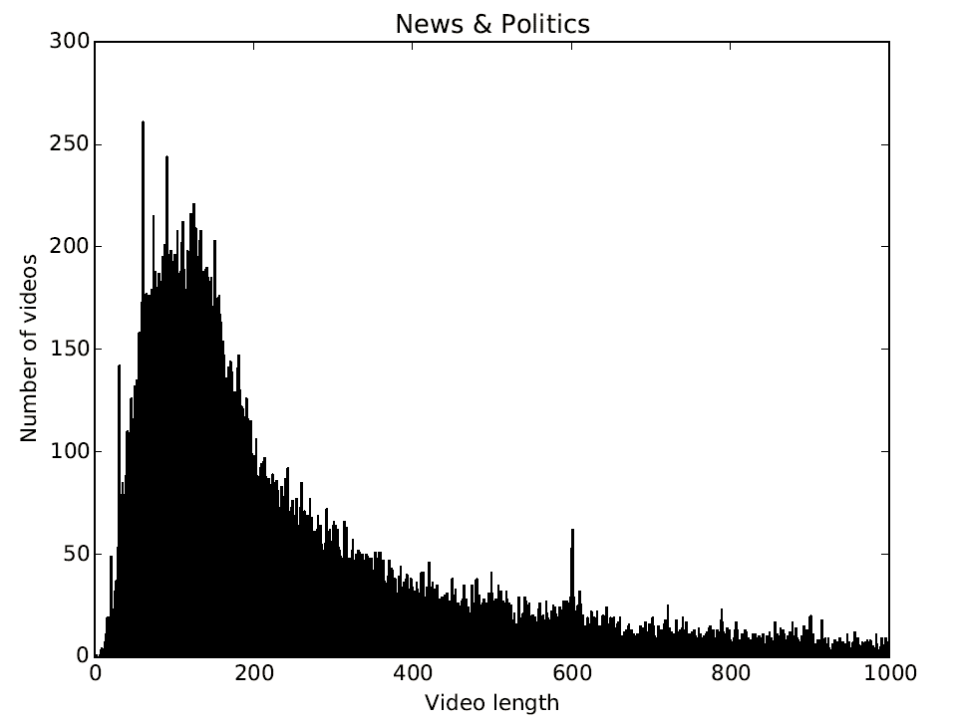
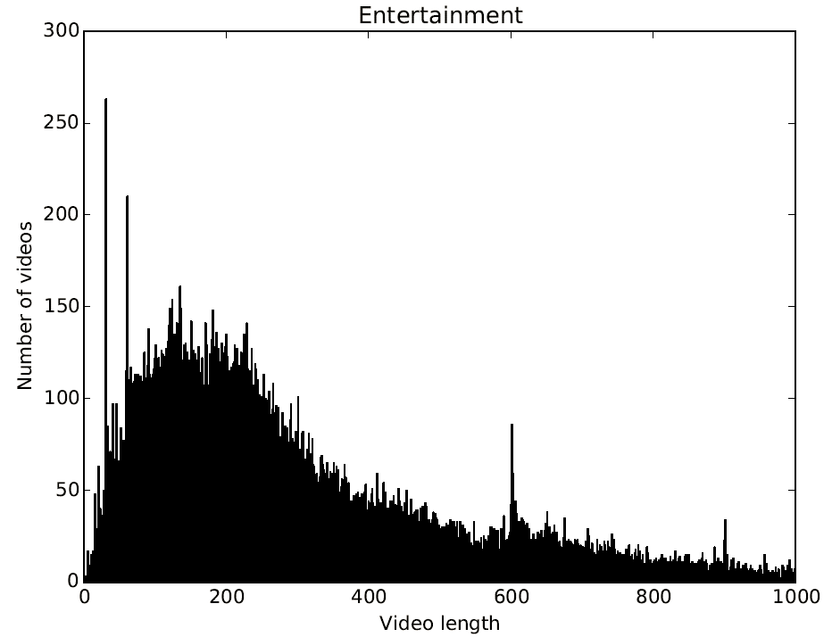
Distribution of YouTube video length for four most popular categories
Rayleigh Distribution for all four categories
Difference variances
Entertainment: cutoff around 10 mins is not obvious
2017 Data Set

Slide 12
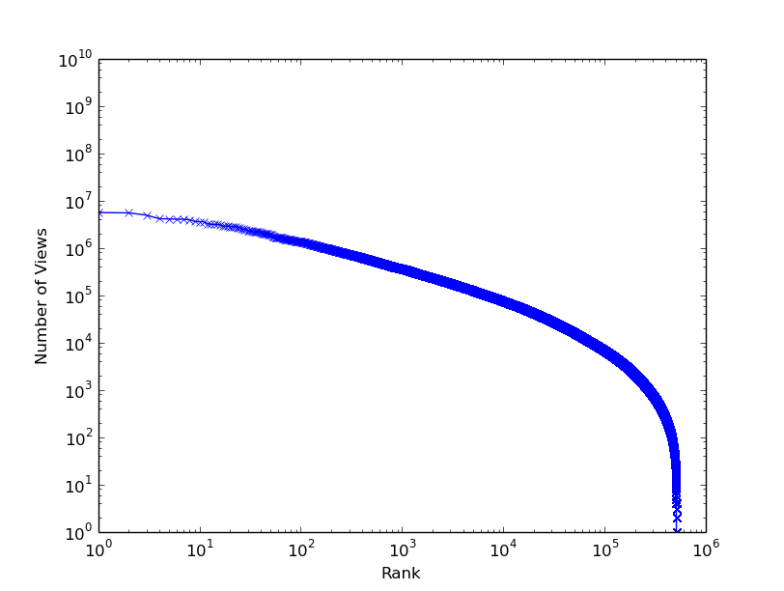
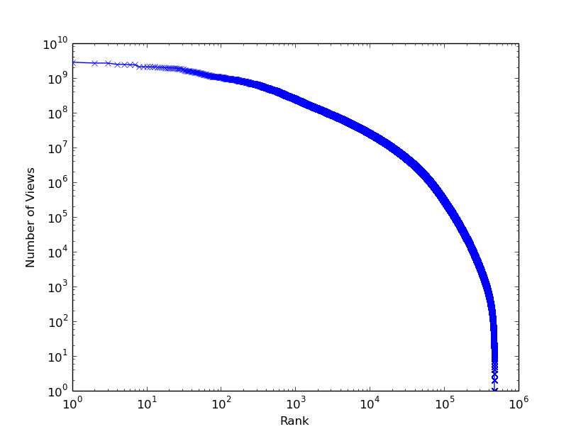
YouTube video rank ordered by popularity
2007 Data Set
2017 Data Set
Growing influence of YouTube video
Notes:
YouTube is more popular as years growing, the most popular video in YouTube in 2017 have been played around 0.5 billion. However, the one in 2007 only have 8 million views. We can see that growing influence of YouTube video.

Slide 13
Correlation Matrix of YouTube metrics with 2017 data set
 | Upload Time | Video Duration | View Count | Comment Count | Like Count | Dislike Count
Upload Time | 1 | 0.013770 | -0.02329 | -0.009954 | -0.00372 | -0.00103
Video Duration | 0.0137702 | 1 | -0.002253 | -0.001564 | -0.002915 | -0.000945
View Count | -0.023294 | -0.002253 | 1 | 0.5994780 | 0.9038008 | 0.5636737
Comment Count | -0.009954 | -0.001564 | 0.5994780 | 1 | 0.6754886 | 0.7984239
Like Count | -0.003729 | -0.002915 | 0.9038008 | 0.6754886 | 1 | 0.5231864
Dislike Count | -0.001030 | -0.000945 | 0.5636737 | 0.79842398 | 0.5231864 | 1
Upload time and duration have no correlation with other metrics
View, comment, like and dislike have correlation with each other

Slide 14
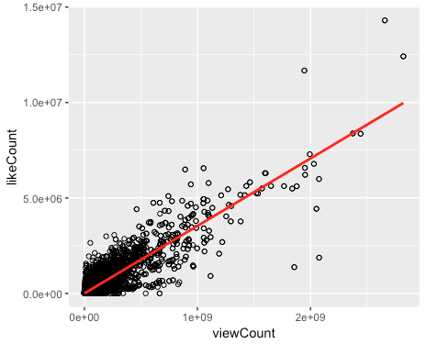
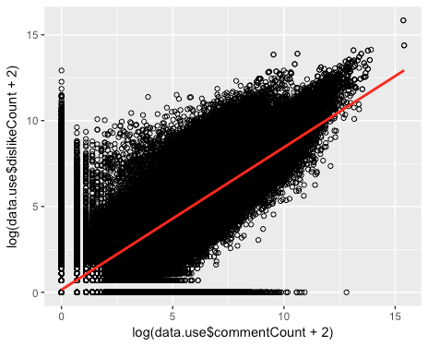
Linear relation between YouTube metrics with 2017 data set
View count V.S. like count
log(comment counts) V.S. dislike counts
If people like the videos they would like to view it more often
If they dislike the video, they are more likely to leave some comments

Slide 15
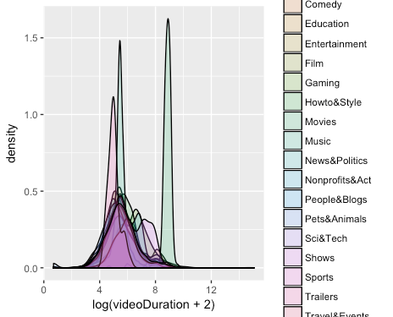
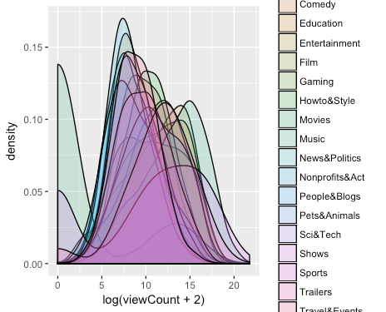
Density of video duration, view counts by category with 2017 data set
Movies have significantly long duration
Users have difference preference on different categories of videos

Slide 16
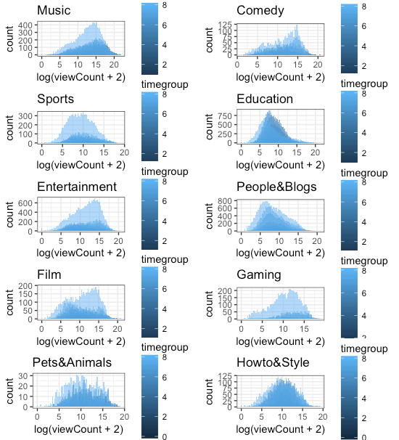
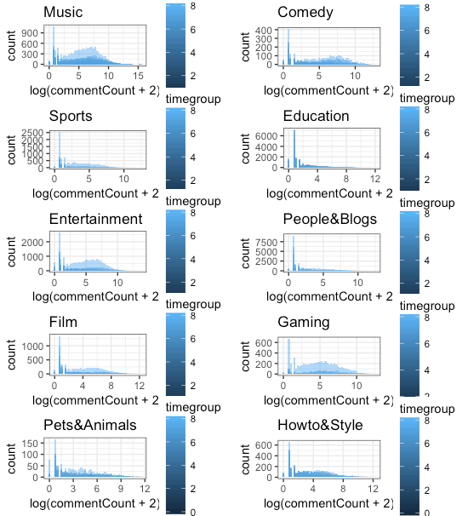
Density of view and comment counts by upload time group for categories with 2017 data set
Music, Sports, Entertainment and Gaming video have significantly both view counts and comments increase

Slide 17
Conclusion
A platform with YouTube API to collect the data from YouTube server
Analysis the YouTube data via Spark
Statistics features of YouTube video and user behaviors in two different time periods
Linear relation among YouTube metrics (like, dislike and comments)

Slide 18


